Slide 1
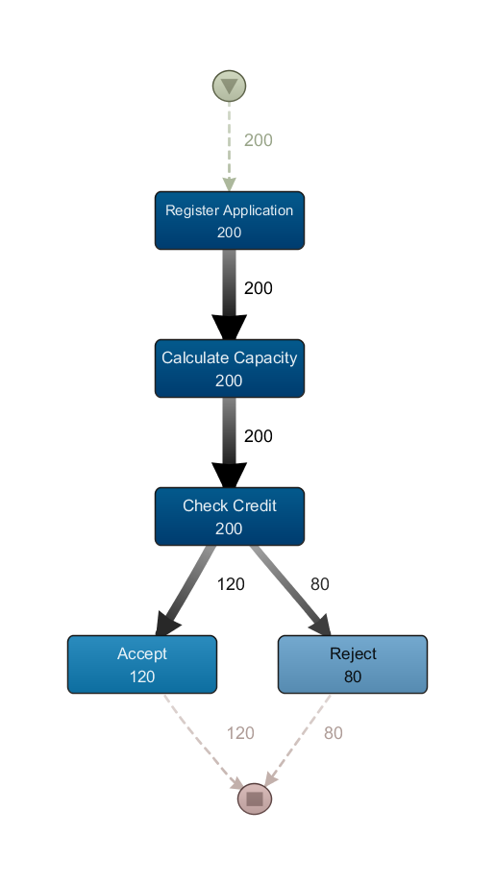
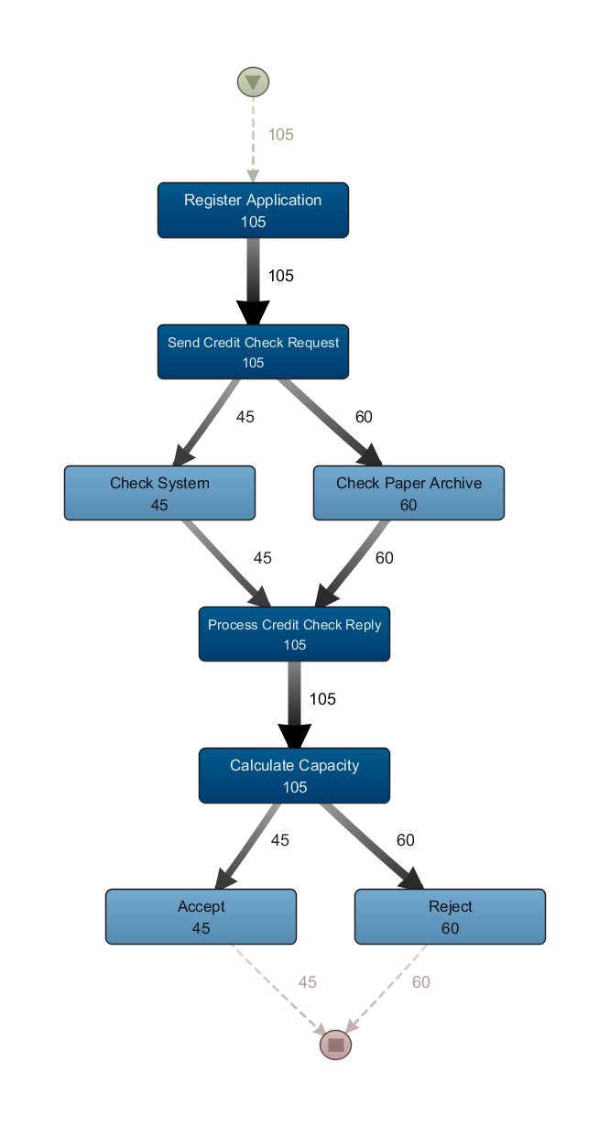
Refined
Activities
Different Moments in Processes
Variant #3(Cluster #1)
Variant #4 (Cluster #2)

